Slide 1
How to set up an IT company in india

Slide 2





Tech Giants in India Use Consulting.

Slide 3
Steps to be followed
Research and Planning
Legal Formalities
Infra Set-up
Building Team
Develop Services
Marketing
Target Audience

Slide 4
1.Research and Planning
a) Identify your Niche(specialization)
Examples of Niche in IT Consulting include:
Cyber Security
Cloud Computing
Data Analytics
Software Development
AI and Machine Learning Solutions
b) Identify Target Audience
c) Summary : overview of mission and vision
d) Financial Plan : Initial funding requirements, projected expenses, revenue streams, and profit margins.

Slide 5
2.Legal Formalities
Business Registration : 5 types
Sole proprietorship
Partnership
Limited Liability Partnership(LLP)
Private Limited Company(Pvt Ltd)
One Person Companyt(OPC)
a and b are suggested , if the company is confined only to the state
c and d are suggested for the Software Company and (CA needed to advise and take care of legal entites)

Slide 6
No of documents and compliances should be submitted to govt every year and it will be done by CA
LLP companies can be converted into Pvt Ltd
Pvt Ltd is more expensive when compared to LLP
In Pvt Ltd Patents and logo , Trademark will be secured by the Govt of India
If there are no customers and not selling anything and if the customer is not checking the “Terms and Conditions” Box No Legal Entity(LLP, Pvt Ltd) is required
If Revenue is generated from the customers then Legal entity is required

Slide 7
Registration (2 types):
ESIC Registration -- Local Labour Department
Not mandatory if employees are < 10 in company
EPFO Registration – Employees Provident Fund(EPF)
Required if employees > 20
GST should be filed for every month or Quarter
Varies for different categories
GST Certificate is required if company turnover >= 40 lakhs
Export Import License (International trading)
if we apply then will be issued by govt of India
We need to pay more amount

Slide 8
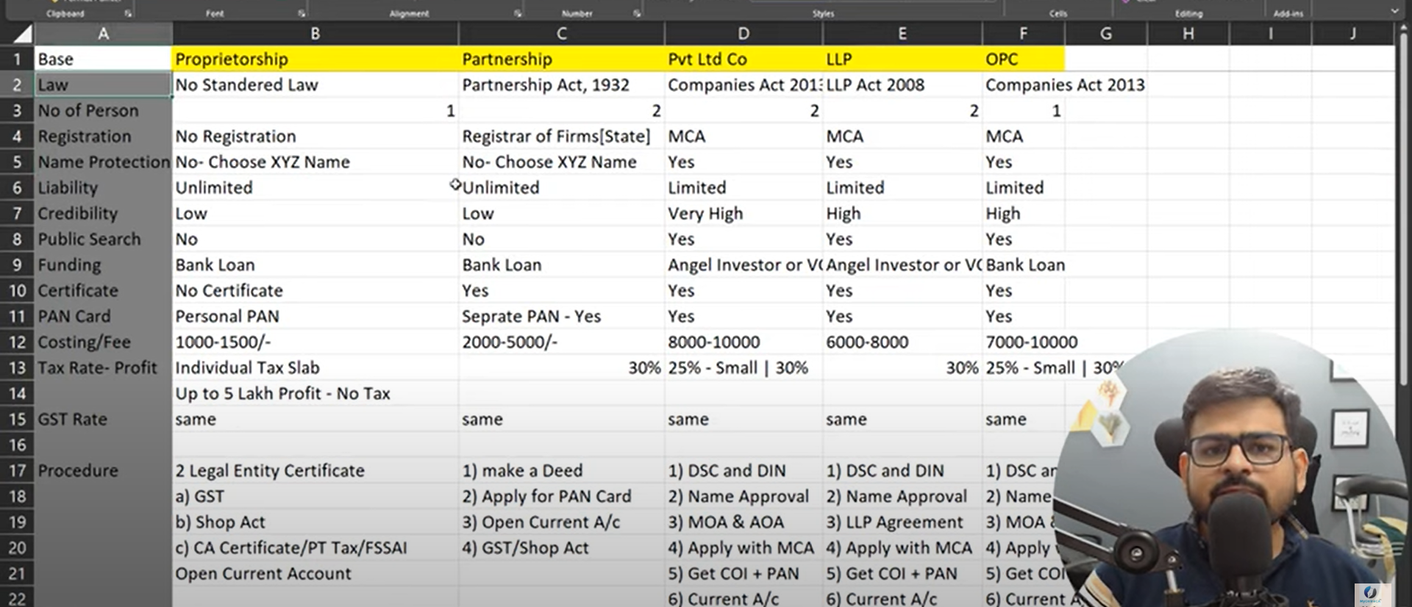

Slide 9
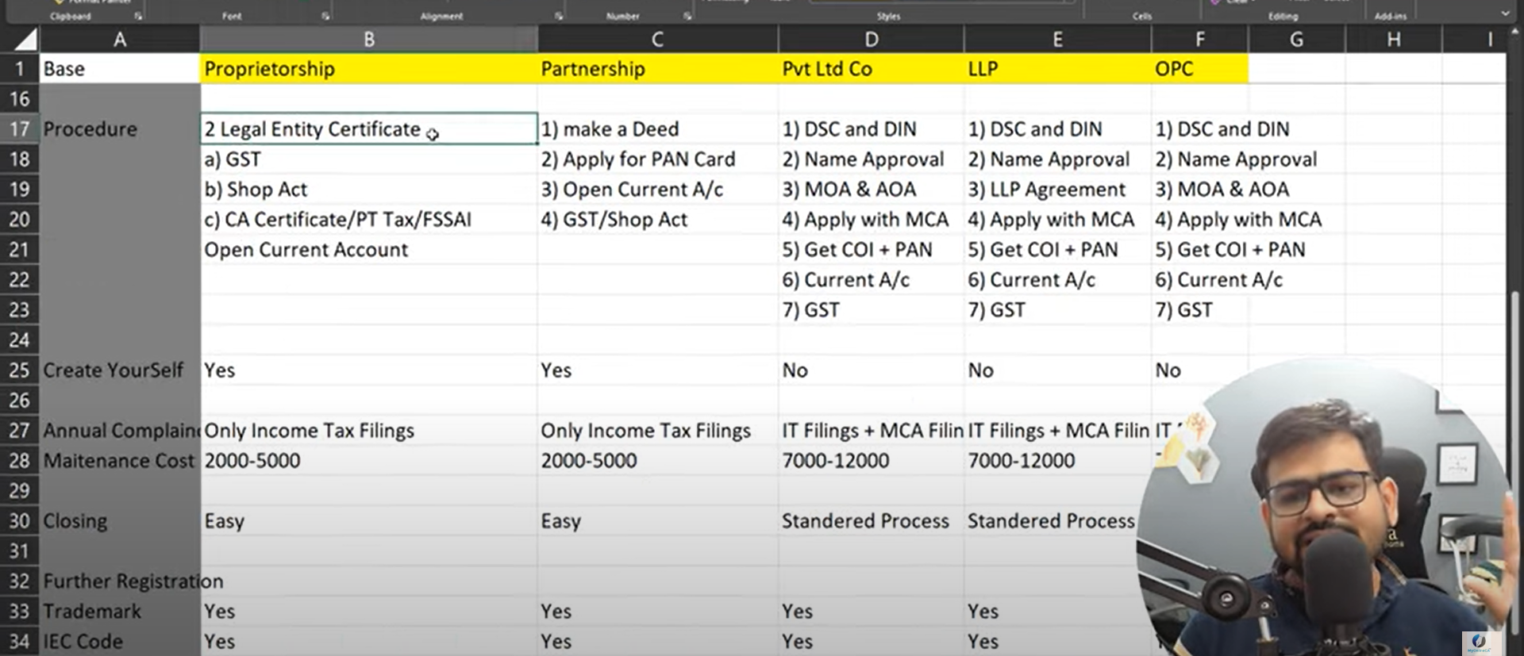

Slide 10
MCA – Ministry of Corporate Affairs
Separate PAN Card will be issued by the Name of the company we are registering
In general, the expenses for registering a company would range in between 8000 to 15000 excluding the charges of CA
We can also get ISO and IEC certificates from Govt
PAN and TAN Cards will be issued by GOVT. Once , the company is successfully registered
PAN – used to pay the govt
TAN – used to pay the people i.e., Employees
MVP(Minimum Viable Product) – Building the sample product with essential features and testing them with small range of customers
Product Market Fit – if MVP is Hit , then go for PMF i.e., testing with large customers to see its reach

Slide 11
THANK YOU

